Slide 1


Plant Disease Prediction Using Symptoms Analysis
Guided By: Presented By:
Prof. Mahendra K. Verma Mo. Furqan Qureshi(0827IT231086)
Sudarshan Rajput (0827IT231136)
Yogesh Mali (0827IT231152)
Zoya Qureshi (0827IT231156)

Slide 2
Contents
Introduction
1.1 Problem Statement
Literature Review
Proposed Solution
3.1 Objectives
System Architecture
Methodology & Workflow
Theoretical Stack
5.1 System Screenshots
Result and Performance
Conclusion & Future Work

Slide 3
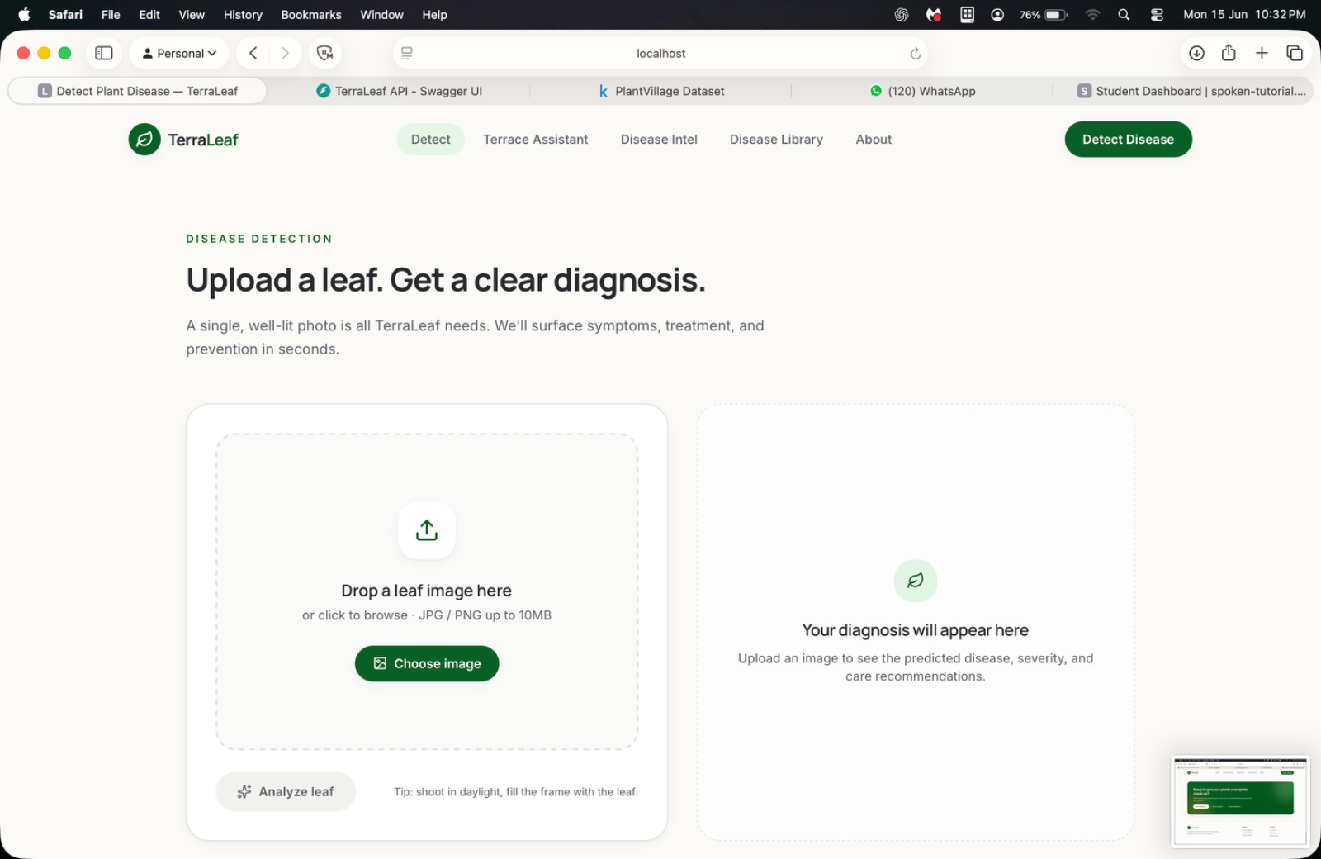
1. Introduction
The Problem
Plant diseases cause 20–40% of global crop losses annually (FAO)
Rural farmers lack timely access to agricultural experts
Existing AI tools depend on high-quality images and internet
No accessible symptom-based prediction system exists for farmers

Slide 4
2. Literature Review
Year | Author(s) | Method | REsult | Limitation
2016 | Mohanty et al. | CNN (PlantVillage) | 99.35% accuracy | Poor real-world generalization
2018 | Liakos et al. | ML Review (RF, SVM) | Validated classical ML | No specific prediction model
2019 | Too et al. | Transfer Learning | 95%+ accuracy | Image quality dependency
2021 | Sharma et al. | Naive Bayes (Symptom) | 84% accuracy | No UI, limited disease scope
2024 | Chen et al. | Explainable AI | Improved transparency | Limited real-world deployment

Slide 5
3. Proposed Solution & Objectives
Propsed Solution
AI-based web app for symptom-driven plant disease prediction
Farmers describe symptoms — no image required
Random Forest ML model trained on 4,460 records
Returns disease name, confidence score & treatment
Key Objective
Develop accessible web-based disease prediction
Achieve high accuracy using ML algorithms
Provide treatment & preventive suggestions
Reduce dependency on agricultural experts

Slide 6
4. System Architecture
Presentation Layer
Symptom Input Form
Optional Image Upload
Result Display Panel
↓
Application Logic Layer
Flask Backend (Python)
Preprocessing Module
Random Forest Classifier
↓
Data Layer
MySQL Database
Firebase Auth

Slide 7
5. Methodology & Workflow
User entre symtomps
22 binary features selected
Random Forest Predectio
200 estimators, depth = 20
Confidence Score
Probability estimation
Result displayed
Disease + Treatment show
Optimal Image upload
OpenCV preprocessing
Data Preprocessing
Encoding + normalization

Slide 8
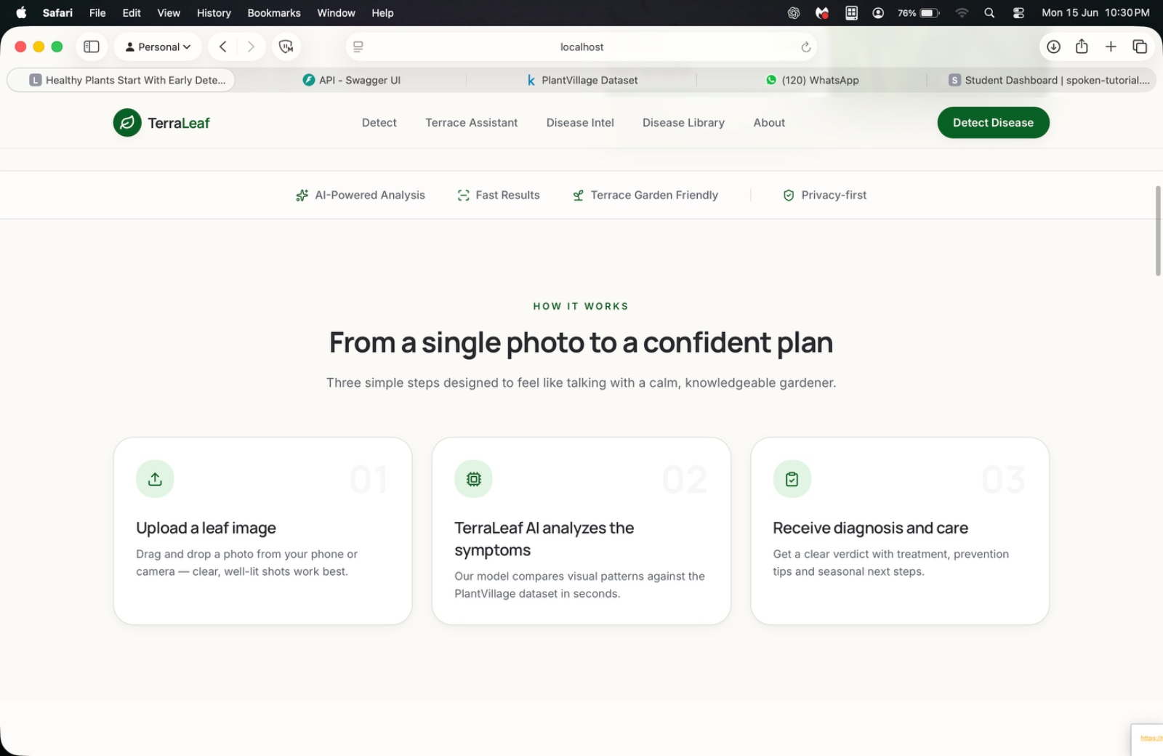
6. Technology Stack
Backend & ML
Frontend
Database & Auth
Python 3.10
HTML5
MySQL 8.0
Flask 2.3.2
CSS3
Firebase 10.x
Scikit-learn 1.3.0
JavaScript
OpenCV 4.8.0
Pandas & NumPy
AJAX
Joblib 1.3.2
Jinja2 Templates

Slide 9
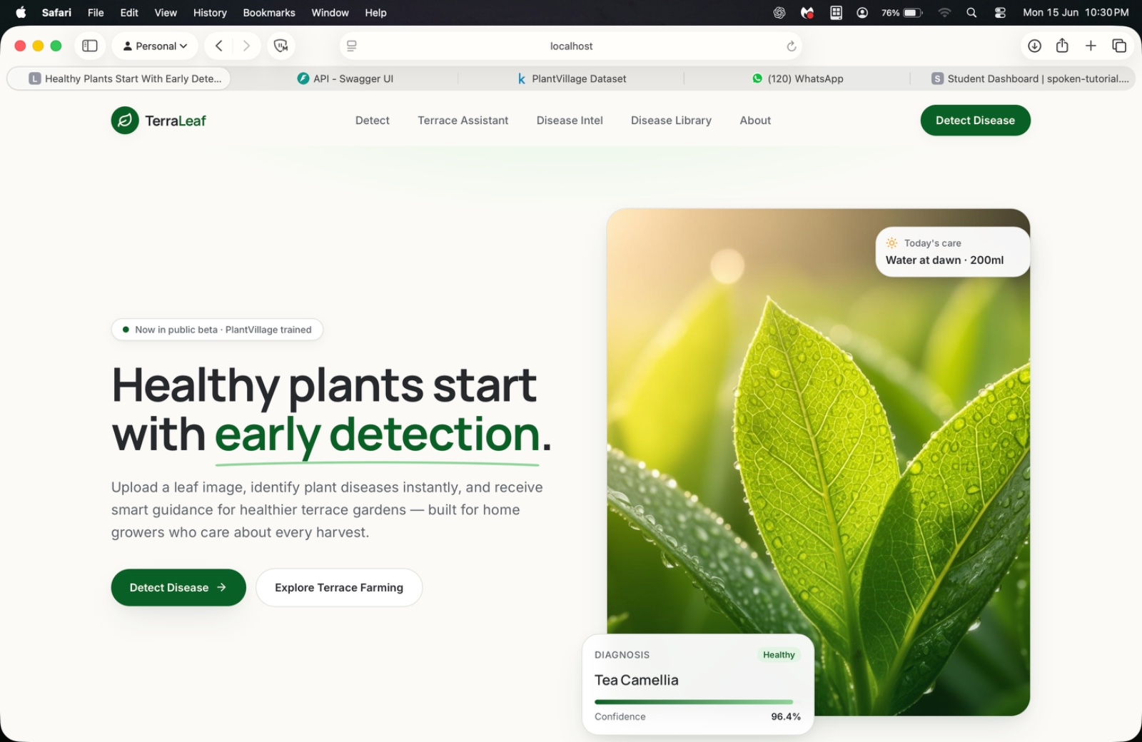
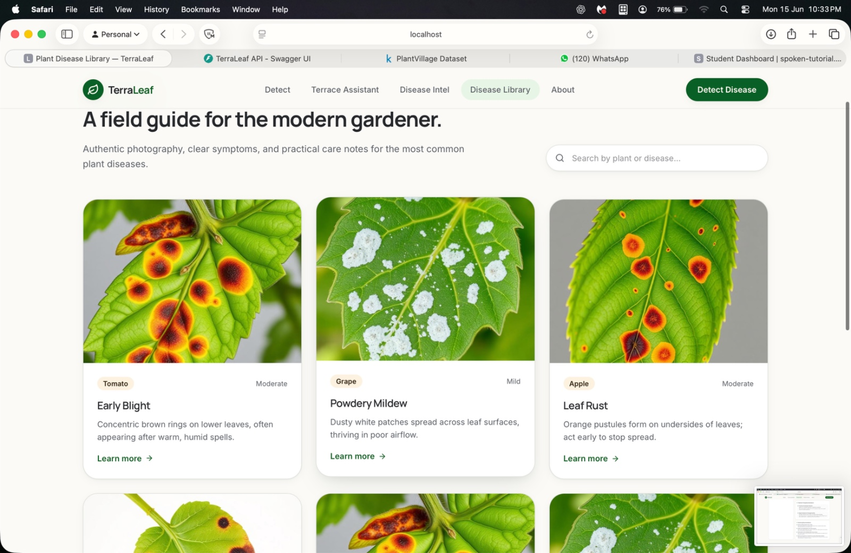
6.1 System Screenshots

Slide 10
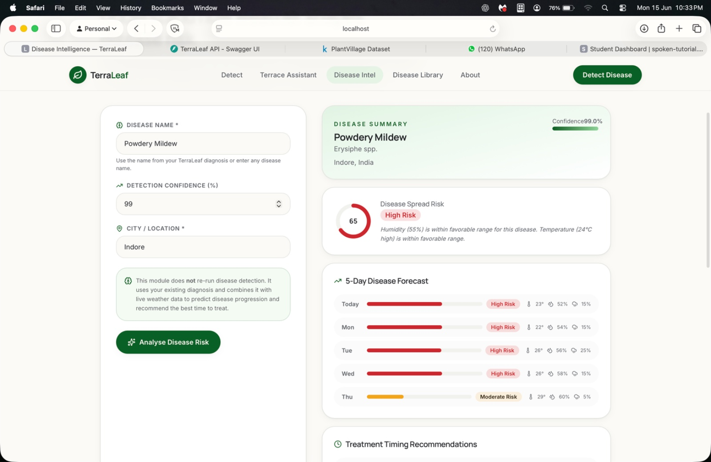
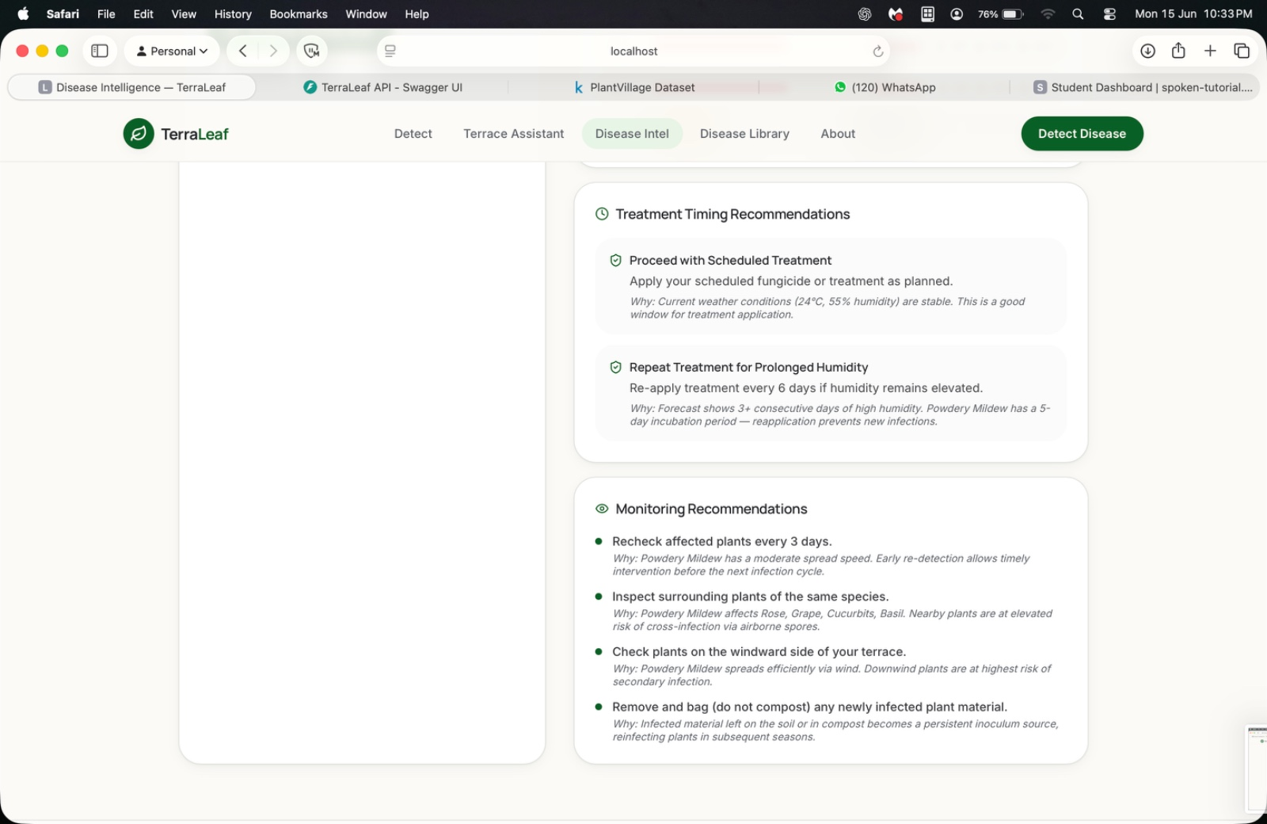
System Screenshots

Slide 11
7. Result & Performance
93.4%
1.2s
15
4,460
Accuracy
Avg Response
Diseases
Records
Random Forest
Symptom only
5 Crop categories
Training dataset
Model
Accuracy
Precision
Recall
F1-Score
Naive Bayes
84.2%
82.7%
81.4%
82.0%
Logistic Regression
88.6%
87.3%
86.1%
86.7%
Random Forest ✓
93.4%
92.1%
91.8%
91.9%

Slide 12
7.1 Comparison with Existing Systems
Feature
Plantix
Leaf Doctor
AgroAI
Our System
Works Without Image
No
No
No
Yes ✓
Confidence Score
No
No
No
Yes ✓
Rural Accessibility
Low
Low
Low
High ✓

Slide 13
8. Conclusion & Future Work
Key Achievements
Future Work
93.4% accuracy using Random Forest classifier
→ Expand to 50+ diseases across more crops
✓ Symptom-based — no image dependency
Integrate MobileNetV3 for image analysis
1.2 second average prediction response time
→ Develop Android app with offline support
✓ Accessible to non-technical rural farmers
Add multilingual support (Hindi, Marathi, Telugu)

Slide 14
GitHub Link
https://github.com/sudarshanr04/EARLY-DISEASE-DETECTION.git

Slide 15
Thank You

